Slide 1
The Grow It Oregon Challenge
OSU EXTENSION SERVICE
Mandy Hatfield
Senior Instructor

Slide 2
Engage Inspire Educate Empower
Notes:
These are the type of choices we engage our audience about in a way that inspires them to learn from the education we provide that leaves them empowered to make healthy choice for themselves and their families.

Slide 3
Empowered to choose ice cream
Notes:
I am not talking about always choosing the healthy options all the time because I can’t imagine life without a little ice cream once in a while. But that our participants feel empowered to make healthy choices.

Slide 4
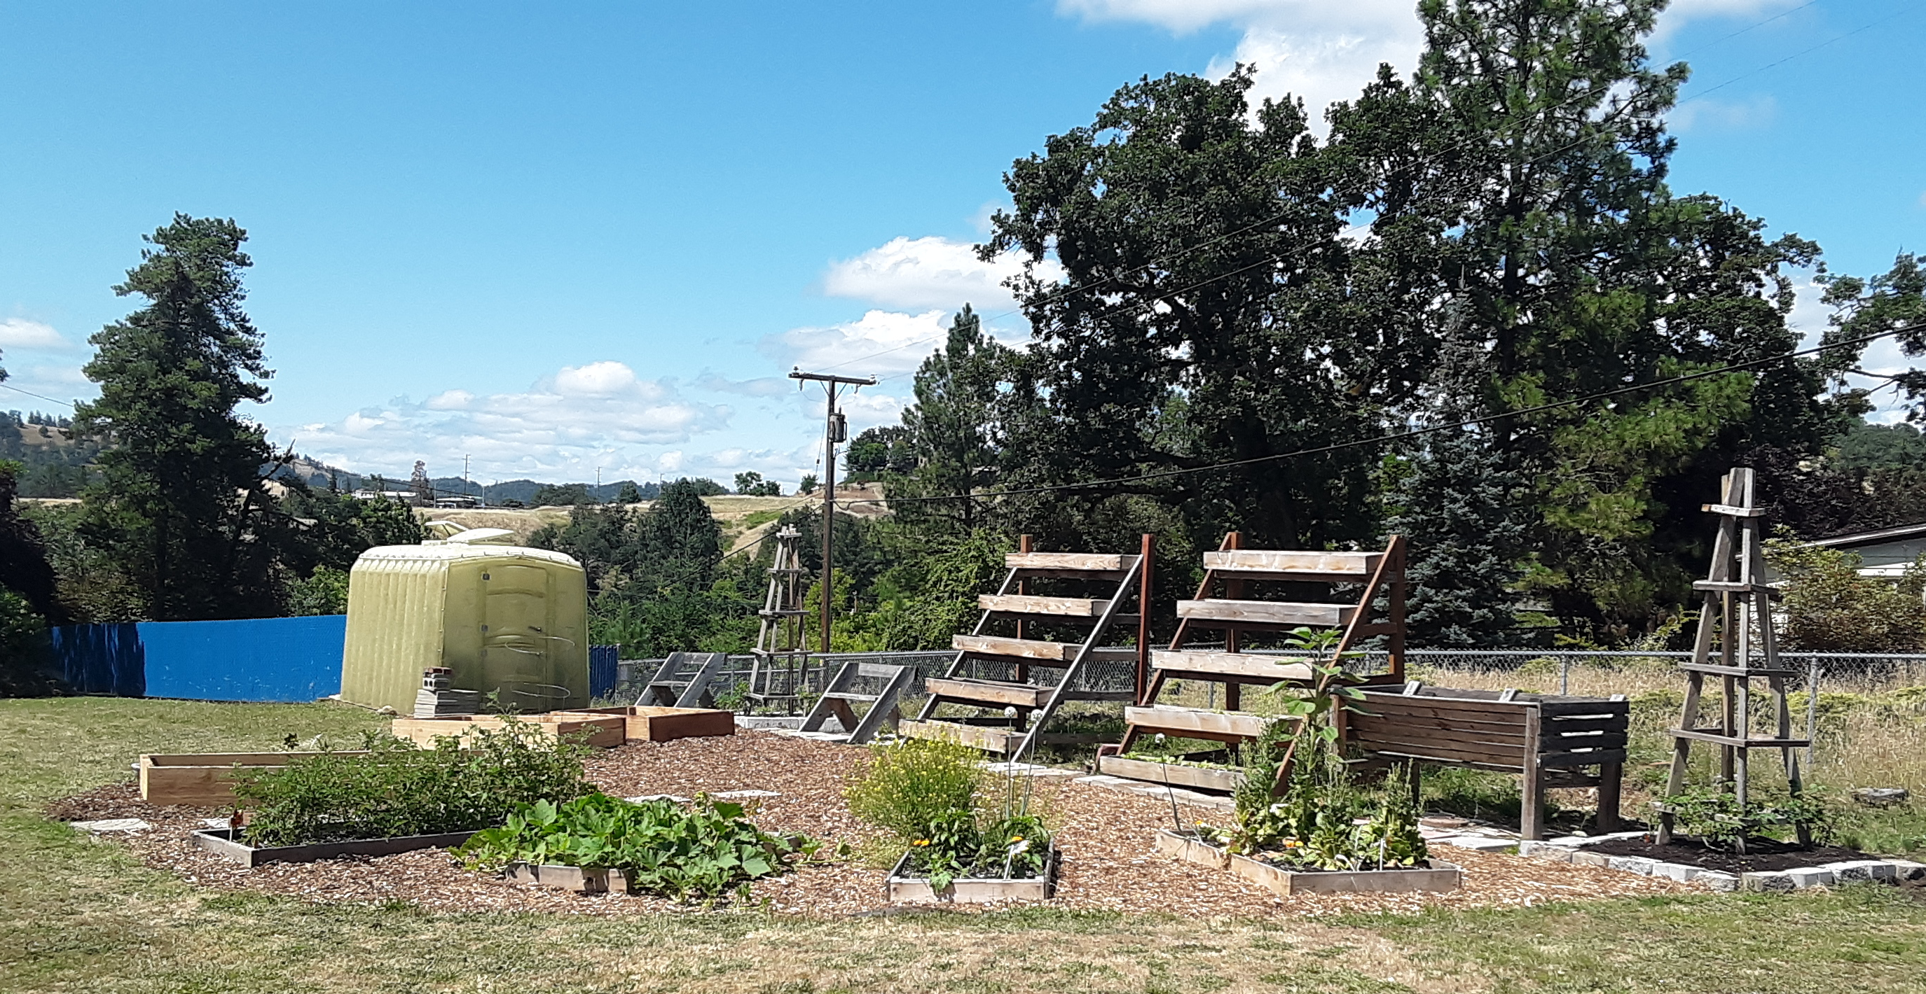
Building gardens
Notes:
In the Douglas SNAP-Ed unit this past year we worked to increase gardening education in schools. This focus came from our work on the Blue Zones Food Policy committee as a community driven need. With the support of Blue Zones and local organizations we secured funds to host an AmeriCorps member to work on creating gardens and gardening education with Roseburg Schools. This picture is of the Winchester Elementary school garden. We started building this garden in January in what was a grass field.

Slide 5
3,500 participants!
Grow this!
Oregon Garden Challenge
Notes:
However when Covid-19 hit we had to find a new way to engage our audience. We look to social media to help find ways to engage our participants in gardening education. However, we saw access to materials as a barrier to some of our audience in following along with the gardening education videos we were creating. With a large donation of seeds from Bi-Mart for use in the schools we looked for help from campus on how we could safely get these seeds distributed to our target audience to participant in our garden education. From this conversation we were able to find an example out of West Virginia were Extension was mailing seeds to participants. We created the Grow It Oregon Gardening Challenge. We were able to engage individuals and groups through social media to sign up for the challenge. We had 3500 individuals and groups sign-up to participate. Each individual signed up received 4 different types of seeds. We reached our maximum participants for this project in just a week and a half.

Slide 6
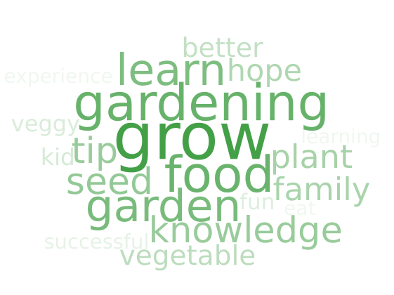
Inspired
by…
Notes:
During sign ups we asked what was your reason to sign up? Participants said to learn gardening, knowledge, tips, grow vegetables. These are the reason people were inspired to participate. The sign up allowed us to provide monthly growing newsletters to participants as well as direct them to the gardening series on the Food Hero YouTube page that we were creating to help participants be successful. Several videos received over 900 views. We offered weekly Q&A time on Facebook live for questions people might have.

Slide 7
Community Partners
Notes:
This project was successful in empowering participants to increase their knowledge of gardening and to grow their own produce which increases availability in the home of fresh fruits and vegetables.
This project and many more that we continue to focus on are part of a partnership of organizations that engage each other through coalitions to find common goals that meet the needs of our community. We will continue to strive to empower Douglas County residents to make healthy choices every day.

Slide 8
What questions do you have?
Mandy Hatfield
Douglas County SNAP-Ed Manager
mandy.Hatfield@oregonstate.edu
541-236-3017

